Slide 1
Managing Backup and Recovery in RAC

Slide 2
Objectives
After completing this lesson, you should be able to:
  Configure the RAC database to use ARCHIVELOG mode and the flash recovery area
  Configure RMAN for the RAC environment
Notes:
Oracle Database 11g: RAC Administration 5 - <number>
Objectives
RAC backup and recovery is almost identical to other Oracle database backup and recovery operations. This is because you are backing up and recovering a single database. The main difference is that with RAC you are dealing with multiple threads of redo log files.

Slide 3



Protecting Against Media Failure
Archived
log files
Archived
log files
Database
backups
Mirrored
disks
Notes:
Protecting Against Media Failure
Although RAC provides you with methods to avoid or to reduce down time due to a failure of one or more (but not all) of your instances, you must still protect the database itself, which is shared by all the instances. This means that you need to consider disk backup and recovery strategies for your cluster database just as you would for a non-clustered database.
To minimize the potential loss of data due to disk failures, you may want to use disk mirroring technology (available from your server or disk vendor). As in non-clustered databases, you can have more than one mirror if your vendor allows it, to help reduce the potential for data loss and to provide you with alternative backup strategies. For example, with your database in ARCHIVELOG mode and with three copies of your disks, you can remove one mirror copy and perform your backup from it while the two remaining mirror copies continue to protect ongoing disk activity. To do this correctly, you must first put the tablespaces into backup mode and then, if required by your cluster or disk vendor, temporarily halt disk operations by issuing the ALTER SYSTEM SUSPEND command. After the statement completes, you can break the mirror and then resume normal operations by executing the ALTER SYSTEM RESUME command and taking the tablespaces out of backup mode.

Slide 4
Archived Log File Configurations
Cluster file system scheme:
Archive logs from each
instance are written to the same file location.
Local archive with NFS scheme: Each instance can read mounted archive destinations of all instances.
Notes:
Archived Log File Configurations
During backup and recovery operations involving archived log files, the Oracle server determines the file destinations and names from the control file. If you use RMAN, the archived log file path names can also be stored in the optional recovery catalog. However, the archived log file path names do not include the node name, so RMAN expects to find the files it needs on the nodes where the channels are allocated.
If you use a cluster file system, your instances can all write to the same archive log destination. This is known as the cluster file system scheme. Backup and recovery of the archive logs are easy because all logs are located in the same directory.
If a cluster file system is not available, then Oracle recommends that local archive log destinations be created for each instance with NFS-read mount points to all other instances. This is known as the local archive with network file system (NFS) scheme. During backup, you can either back up the archive logs from each host or select one host to perform the backup for all archive logs. During recovery, one instance may access the logs from any host without having to first copy them to the local destination.
Using either scheme, you may want to provide a second archive destination to avoid single points of failure.

Slide 5
RAC and the Flash Recovery Area
Flash
recovery
area
Cluster file system
Certified NFS
directory
ASM
Notes:
RAC and the Flash Recovery Area
To use a flash recovery area in RAC, you must place it on an ASM disk group, a cluster file system, or on a shared directory that is configured through certified NFS for each RAC instance. That is, the flash recovery area must be shared among all the instances of a RAC database.

Slide 6
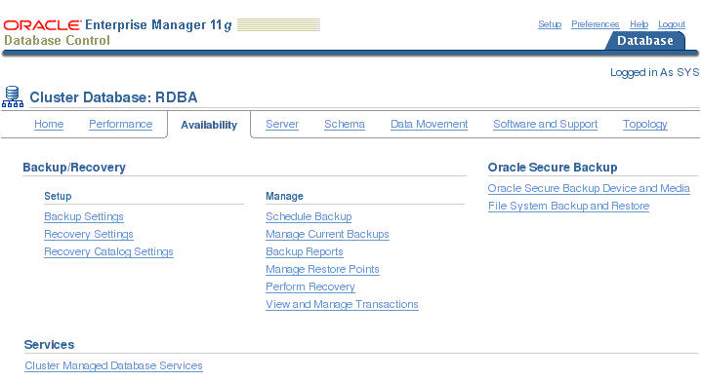
RAC Backup and Recovery Using EM
Notes:
RAC Backup and Recovery Using EM
You access the Cluster Database backup and recovery related tasks by clicking the Availability tab on the Cluster Database home page. On the Availability tabbed page, you can use RMAN to perform a range of backup and recovery operations, such as scheduling backups, performing recovery when necessary, and configuring backup and recovery settings. There are also links related to Oracle Secure Backup and Service management.

Slide 7
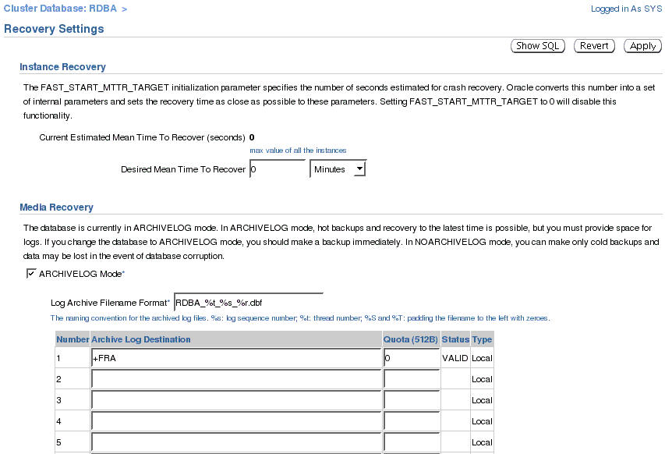
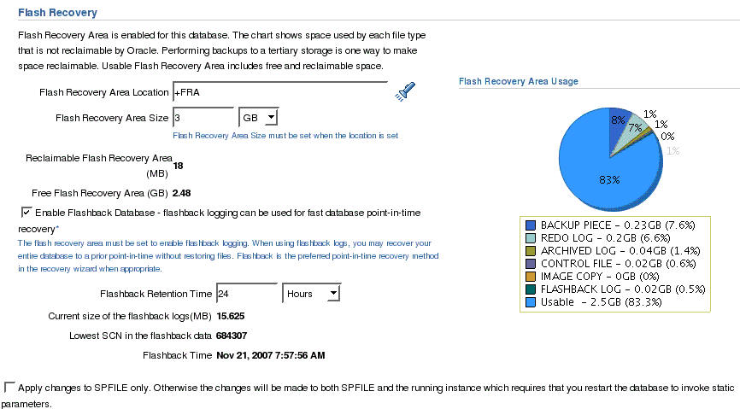
Configure RAC Recovery Settings with EM
Notes:
Configure RAC Recovery Settings with EM
You can use Enterprise Manager to configure important recovery settings for your cluster database. On the Database home page, click the Availability tab, and then click the Recovery Settings link. From here, you can ensure that your database is in archivelog mode and configure flash recovery settings.
With a RAC database, if the Archive Log Destination setting is not the same for all instances, the field appears blank, with a message indicating that instances have different settings for this field. In this case, entering a location in this field sets the archive log location for all instances of database. You can assign instance specific values for an archive log destination by using the Initialization Parameters page.
Note: You can run the ALTER DATABASE SQL statement to change the archiving mode in RAC as long as the database is mounted by the local instance but not open in any instances. You do not need to modify parameter settings to run this statement. Set the initialization parameters DB_RECOVERY_FILE_DEST and DB_RECOVERY_FILE_DEST_SIZE to the same values on all instances to configure a flash recovery area in a RAC environment.

Slide 8
Archived Redo File Conventions in RAC
Parameter | Description | Example
%r | Resetlogs identifier | log_1_62_23452345
%R | Padded resetlogs identifier | log_1_62_0023452345
%s | Log sequence number, not padded | log_251
%S | Log sequence number, left-zero-padded | log_0000000251
%t | Thread number, not padded | log_1
%T | Thread number, left-zero-padded | log_0001
Notes:
Archived Redo File Conventions in RAC
For any archived redo log configuration, uniquely identify the archived redo logs with the LOG_ARCHIVE_FORMAT parameter. The format of this parameter is operating system specific and it can include text strings, one or more variables, and a file name extension.
All of the thread parameters, in either upper or lower case, are mandatory for RAC. This enables the Oracle database to create unique names for archive logs across the incarnation. This requirement is in effect when the COMPATIBLE parameter is set to 10.0 or greater. Use the %R or %r parameter to include the resetlogs identifier to avoid overwriting the logs from a previous incarnation. If you do not specify a log format, then the default is operating system specific and includes %t, %s, and %r.
As an example, if the instance associated with redo thread number 1 sets LOG_ARCHIVE_FORMAT to log_%t_%s_%r.arc, then its archived redo log files are named as:
log_1_1000_23435343.arc
log_1_1001_23452345.arc
log_1_1002_23452345.arc
...

Slide 9
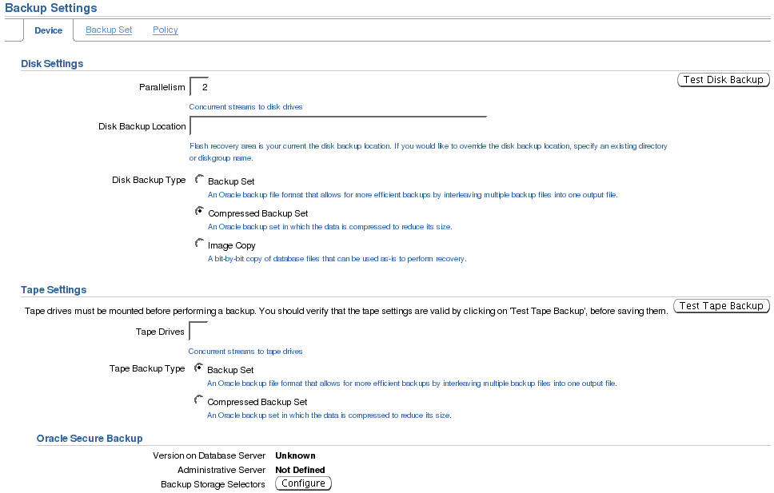
Configure RAC Backup Settings with EM
Notes:
Configure RAC Backup Settings with EM
Persistent backup settings can be configured using Enterprise Manager. On the Database Control home page, click the Availability tab, and then click the Backup Settings link. You can configure disk settings such as the directory location of your disk backups, and level of parallelism. You can also choose the default backup type:
Backup set
Compressed backup set
Image copy
You can also specify important tape-related settings such as the number of available tape drives and vendor-specific media management parameters.

Slide 10
Oracle Recovery Manager
Recovery
Manager
RMAN provides the following benefits for Real Application Clusters:
  Can read cluster files or raw partitions with no configuration changes
  Can access multiple archive log destinations
Recovery
catalog
Archived
log files
Oracle
Server
process
Stored
scripts
Oracle
database
Backup storage
Snapshot
control file
Notes:
Oracle Recovery Manager
Oracle Recovery Manager (RMAN) can use stored scripts, interactive scripts, or an interactive GUI front end. When using RMAN with your RAC database, use stored scripts to initiate the backup and recovery processes from the most appropriate node.
If you use different Oracle Home locations for your RAC instances on each of your nodes, create a snapshot control file in a location that exist on all your nodes. The snapshot control file is only needed on the nodes on which RMAN performs backups. The snapshot control file does not need to be globally available to all instances in a RAC environment though.
You can use either a cluster file or a shared raw device as well as a local directory that exists on each node in your cluster. Here is an example:
RMAN> CONFIGURE SNAPSHOT CONTROLFILE TO '/oracle/db_files/snaps/snap_prod1.cf';
For recovery, you must ensure that each recovery node can access the archive log files from all instances by using one of the archive schemes discussed earlier, or make the archived logs available to the recovering instance by copying them from another location.

Slide 11
Configure RMAN Snapshot Control File Location
  The snapshot control file path must be valid on every node from which you might initiate an RMAN backup.
  Configure the snapshot control file location in RMAN.
    Determine the current location:
    You can use ASM, a shared file system location or a shared block device if you prefer:
RMAN> SHOW SNAPSHOT CONTROLFILE NAME;
/u01/app/oracle/product/11.1.0/dbs/scf/snap_prod.cf
RMAN> CONFIGURE SNAPSHOT CONTROLFILE NAME TO '+FRA/SNAP/snap_prod.cf';
RMAN> CONFIGURE SNAPSHOT CONTROLFILE NAME TO '/ocfs/oradata/dbs/scf/snap_prod.cf';
RMAN> CONFIGURE SNAPSHOT CONTROLFILE NAME TO '/dev/sdj2';
Notes:
Configure RMAN Snapshot Control File Location
The snapshot control file is a temporary file that RMAN creates to resynchronize from a read-consistent version of the control file. RMAN needs a snapshot control file only when resynchronizing with the recovery catalog or when making a backup of the current control file.
In a RAC database, the snapshot control file is created on the node that is making the backup. You need to configure a default path and file name for these snapshot control files that are valid on every node from which you might initiate an RMAN backup.
Run the following RMAN command to determine the configured location of the snapshot control file:
SHOW SNAPSHOT CONTROLFILE NAME
You can change the configured location of the snapshot control file. For example, on UNIX-based systems you can specify the snapshot control file location as snap_prod.cf located in the ASM disk group +FRA by entering the following at the RMAN prompt:
CONFIGURE SNAPSHOT CONTROLFILE NAME TO '+FRA/SNAP/snap_prod.cf'
This command globally sets the configuration for the location of the snapshot control file throughout your cluster database.
Note: The CONFIGURE command creates persistent settings across RMAN sessions.

Slide 12
Configure Control File and SPFILE Autobackup
  RMAN automatically creates a control file and SPFILE backup after BACKUP or COPY:
  Change default location:
  Location must be available to all nodes in your RAC database.
RMAN> CONFIGURE CONTROLFILE AUTOBACKUP ON;
RMAN> CONFIGURE CONTROLFILE AUTOBACKUP FORMAT FOR DEVICE TYPE DISK TO '+FRA';
Notes:
Configure Control File and SPFILE Autobackup
If you set CONFIGURE CONTROLFILE AUTOBACKUP to ON, RMAN automatically creates a control file and an SPFILE backup after you run the BACKUP or COPY command. RMAN can also automatically restore an SPFILE if required to start an instance to perform recovery. This means that the default location for the SPFILE must be available to all nodes in your RAC database.
These features are important in disaster recovery because RMAN can restore the control file even without a recovery catalog. RMAN can restore an autobackup of the control file even after the loss of both the recovery catalog and the current control file.
You can change the default name that RMAN gives to this file with the CONFIGURE CONTROLFILE AUTOBACKUP FORMAT command. If you specify an absolute path name in this command, this path must exist identically on all nodes that participate in backups.
Note: RMAN performs the control file autobackup on the first allocated channel. When you allocate multiple channels with different parameters (especially if you allocate a channel with the CONNECT command), you must determine which channel will perform the automatic backup. Always allocate the channel for the connected node first.

Slide 13
Crosschecking on Multiple RAC Clusters Nodes
When cross-checking on multiple nodes make sure all backups can be accessed by every node in the cluster.
  This allows you to allocate channels at any node in the cluster during restore or cross-check operations
  Otherwise you must allocate channels on multiple nodes by providing the CONNECT option to the CONFIGURE CHANNEL command
  If backups are not accessible because no channel was configured on the node that can access those backups, the backups are marked EXPIRED.
Notes:
Crosschecking on Multiple RAC Clusters Nodes
When cross-checking on multiple RAC nodes, configure the cluster so that all backups can be accessed by every node, regardless of which node created the backup. When the cluster is configured this way, you can allocate channels at any node in the cluster during restore or cross-check operations.
If you cannot configure the cluster so that each node can access all backups, then, during restore and cross-check operations, you must allocate channels on multiple nodes by providing the CONNECT option to the CONFIGURE CHANNEL command so that every backup can be accessed by at least one node. If some backups are not accessible during cross-check because no channel was configured on the node that can access those backups, the backups are marked EXPIRED in the RMAN repository after the cross-check.
For example, you can use CONFIGURE CHANNEL ... CONNECT in an Oracle RAC configuration in which tape backups are created on various nodes in the cluster and each backup is accessible only on the node on which it is created.

Slide 14
Channel Connections to Cluster Instances
  During backup, each allocated channel can connect to a different instance in the cluster.
  Instances to which the channels connect must be either all mounted or all open.
CONFIGURE DEFAULT DEVICE TYPE TO sbt;
CONFIGURE DEVICE TYPE sbt PARALLELISM 3;
CONFIGURE CHANNEL 1 DEVICE TYPE sbt CONNECT='sys/rac@RACDB1';
CONFIGURE CHANNEL 2 DEVICE TYPE sbt CONNECT='sys/rac@RACDB2';
CONFIGURE CHANNEL 3 DEVICE TYPE sbt CONNECT='sys/rac@RACDB3';
or
CONFIGURE DEFAULT DEVICE TYPE TO sbt;
CONFIGURE DEVICE TYPE sbt PARALLELISM 3;
CONFIGURE CHANNEL DEVICE TYPE sbt CONNECT='sys/rac@BR';
Notes:
Channel Connections to Cluster Instances
When making backups in parallel, RMAN channels can connect to a different instance in the cluster. The examples in the slide illustrate two possible configurations:
If you want to dedicate channels to specific instances, you can control at which instance the channels are allocated by using separate connect strings for each channel configuration as shown by the first example.
If you define a special service for your backup and recovery jobs, you can use the second example shown in the slide. If you configure this service with load balancing turned on, the channels are allocated at a node as decided by the load-balancing algorithm.
During backup, the instances to which the channels connect must be either all mounted or all open. For example, if the RACDB1 instance has the database mounted but the RACDB2 and RACDB3 instances have the database open, the backup fails.
Note: In some cluster database configurations, some nodes of the cluster have faster access to certain data files than to other data files. RMAN automatically detects this, which is known as node affinity awareness. When deciding which channel to use to back up a particular data file, RMAN gives preference to the nodes with faster access to the data files that you want to back up. For example, if you have a three-node cluster, and if node 1 has faster read/write access to data files 7, 8, and 9 than do the other nodes, then node 1 has greater node affinity to those files than nodes 2 and 3 and RMAN will take advantage of this automatically.

Slide 15
RMAN Channel Support for the Grid
  RAC allows the use of nondeterministic connect strings.
  It simplifies the use of parallelism with RMAN in a RAC environment.
  It uses the load-balancing characteristics of the grid environment.
    Channels connect to RAC instances that are the least loaded.
CONFIGURE DEFAULT DEVICE TYPE TO sbt;
CONFIGURE DEVICE TYPE sbt PARALLELISM 3;
Notes:
RMAN Channel Support for the Grid
In Oracle Database 10g, RAC allows the use of nondeterministic connect strings that can connect to different instances based on RAC features such as load balancing. Therefore, to support RAC, the RMAN polling mechanism no longer depends on deterministic connect strings, and makes it possible to use RMAN with connect strings that are not bound to a specific instance in the grid environment. Previously, if you wanted to use RMAN parallelism and spread a job between many instances, you had to manually allocate an RMAN channel for each instance. In Oracle Database 10g, to use dynamic channel allocation, you do not need separate CONFIGURE CHANNEL CONNECT statements anymore. You only need to define your degree of parallelism by using a command such as CONFIGURE DEVICE TYPE disk PARALLELISM, and then run backup or restore commands. RMAN then automatically connects to different instances and does the job in parallel. The grid environment selects the instances that RMAN connects to, based on load balancing. As a result of this, configuring RMAN parallelism in a RAC environment becomes as simple as setting it up in a non-RAC environment. By configuring parallelism when backing up or recovering a RAC database, RMAN channels are dynamically allocated across all RAC instances.
Note: RMAN has no control over the selection of the instances. If you require a guaranteed connection to an instance, you should provide a connect string that can connect only to the required instance.

Slide 16
RMAN Default Autolocation
  Recovery Manager autolocates the following files:
    Backup pieces
    Archived redo logs during backup
    Data file or control file copies
  If local archiving is used, a node can read only those archived logs that were generated on that node.
  When restoring, a channel connected to a specific node restores only those files that were backed up to the node.
Notes:
RMAN Default Autolocation
Recovery Manager automatically discovers which nodes of a RAC configuration can access the files that you want to back up or restore. Recovery Manager autolocates the following files:
Backup pieces during backup or restore
Archived redo logs during backup
Data file or control file copies during backup or restore
If you use a noncluster file system local archiving scheme, then a node can read only those archived redo logs that were generated by an instance on that node. RMAN never attempts to back up archived redo logs on a channel that it cannot read.
During a restore operation, RMAN automatically performs the autolocation of backups. A channel connected to a specific node attempts to restore only those files that were backed up to the node. For example, assume that log sequence 1001 is backed up to the drive attached to node 1, whereas log 1002 is backed up to the drive attached to node 2. If you then allocate channels that connect to each node, then the channel connected to node 1 can restore log 1001 (but not 1002), and the channel connected to node 2 can restore log 1002 (but not 1001).

Slide 17
Distribution of Backups
Three possible backup configurations for RAC:
  A dedicated backup server performs and manages backups for the cluster and the cluster database.
  One node has access to a local backup appliance and performs and manages backups for the cluster database.
  Each node has access to a local backup appliance and can write to its own local backup media.
Notes:
Distribution of Backups
When configuring the backup options for RAC, you have three possible configurations:
Network backup server: A dedicated backup server performs and manages backups for the cluster and the cluster database. None of the nodes have local backup appliances.
One local drive: One node has access to a local backup appliance and performs and manages backups for the cluster database. All nodes of the cluster should be on a cluster file system to be able to read all data files, archived redo logs, and SPFILEs. It is recommended that you do not use the noncluster file system archiving scheme if you have backup media on only one local drive.
Multiple drives: Each node has access to a local backup appliance and can write to its own local backup media.
In the cluster file system scheme, any node can access all the data files, archived redo logs, and SPFILEs. In the noncluster file system scheme, you must write the backup script so that the backup is distributed to the correct drive and path for each node. For example, node 1 can back up the archived redo logs whose path names begin with /arc_dest_1, node 2 can back up the archived redo logs whose path names begin with /arc_dest_2, and node 3 can back up the archived redo logs whose path names begin with /arc_dest_3.

Slide 18
One Local Drive CFS Backup Scheme
RMAN> CONFIGURE DEVICE TYPE sbt PARALLELISM 1;
RMAN> CONFIGURE DEFAULT DEVICE TYPE TO sbt;
RMAN> BACKUP DATABASE PLUS ARCHIVELOG DELETE INPUT;
Notes:
One Local Drive CFS Backup Scheme
In a cluster file system backup scheme, each node in the cluster has read access to all the data files, archived redo logs, and SPFILEs. This includes Automated Storage Management (ASM), cluster file systems, and Network Attached Storage (NAS).
When backing up to only one local drive in the cluster file system backup scheme, it is assumed that only one node in the cluster has a local backup appliance such as a tape drive. In this case, run the following one-time configuration commands:
CONFIGURE DEVICE TYPE sbt PARALLELISM 1;
CONFIGURE DEFAULT DEVICE TYPE TO sbt;
Because any node performing the backup has read/write access to the archived redo logs written by the other nodes, the backup script for any node is simple:
BACKUP DATABASE PLUS ARCHIVELOG DELETE INPUT;
In this case, the tape drive receives all data files, archived redo logs, and SPFILEs.

Slide 19
Multiple Drives CFS Backup Scheme
CONFIGURE DEVICE TYPE sbt PARALLELISM 3;
CONFIGURE DEFAULT DEVICE TYPE TO sbt;
CONFIGURE CHANNEL 1 DEVICE TYPE sbt CONNECT 'usr1/pwd1@n1';
CONFIGURE CHANNEL 2 DEVICE TYPE sbt CONNECT 'usr2/pwd2@n2';
CONFIGURE CHANNEL 3 DEVICE TYPE sbt CONNECT 'usr3/pwd3@n3';
BACKUP DATABASE PLUS ARCHIVELOG DELETE INPUT;
Notes:
Multiple Drives CFS Backup Scheme
When backing up to multiple drives in the cluster file system backup scheme, it is assumed that each node in the cluster has its own local tape drive. Perform the following one-time configuration so that one channel is configured for each node in the cluster. This is a one-time configuration step. For example, enter the following at the RMAN prompt:
CONFIGURE DEVICE TYPE sbt PARALLELISM 3;
CONFIGURE DEFAULT DEVICE TYPE TO sbt;
CONFIGURE CHANNEL 1 DEVICE TYPE sbt CONNECT 'user1/passwd1@node1';
CONFIGURE CHANNEL 2 DEVICE TYPE sbt CONNECT 'user2/passwd2@node2';
CONFIGURE CHANNEL 3 DEVICE TYPE sbt CONNECT 'user3/passwd3@node3';
Similarly, you can perform this configuration for a device type of DISK. The following backup script, which you can run from any node in the cluster, distributes the data files, archived redo logs, and SPFILE backups among the backup drives:
BACKUP DATABASE PLUS ARCHIVELOG DELETE INPUT;
For example, if the database contains 10 data files and 100 archived redo logs are on disk, then the node 1 backup drive can back up data files 1, 3, and 7 and logs 1–33. Node 2 can back up data files 2, 5, and 10 and logs 34–66. The node 3 backup drive can back up data files 4, 6, 8, and 9 as well as archived redo logs 67–100.

Slide 20
Non-CFS Backup Scheme
CONFIGURE DEVICE TYPE sbt PARALLELISM 3;
CONFIGURE DEFAULT DEVICE TYPE TO sbt;
CONFIGURE CHANNEL 1 DEVICE TYPE sbt CONNECT 'usr1/pwd1@n1';
CONFIGURE CHANNEL 2 DEVICE TYPE sbt CONNECT 'usr2/pwd2@n2';
CONFIGURE CHANNEL 3 DEVICE TYPE sbt CONNECT 'usr3/pwd3@n3';
BACKUP DATABASE PLUS ARCHIVELOG DELETE INPUT;
Notes:
Non-CFS Backup Scheme
In a noncluster file system environment, each node can back up only its own local archived redo logs. For example, node 1 cannot access the archived redo logs on node 2 or node 3 unless you configure the network file system for remote access. To configure NFS, distribute the backup to multiple drives. However, if you configure NFS for backups, then you can back up to only one drive.
When backing up to multiple drives in a noncluster file system backup scheme, it is assumed that each node in the cluster has its own local tape drive. You can perform a similar one-time configuration as the one shown in the slide to configure one channel for each node in the cluster. Similarly, you can perform this configuration for a device type of DISK. Develop a production backup script for whole database backups that you can run from any node. With the BACKUP example, the data file backups, archived redo logs, and SPFILE backups are distributed among the different tape drives. However, channel 1 can read only the logs archived locally on /arc_dest_1. This is because the autolocation feature restricts channel 1 to back up only the archived redo logs in the /arc_dest_1 directory. Because node 2 can read files only in the /arc_dest_2 directory, channel 2 can back up only the archived redo logs in the /arc_dest_2 directory, and so on. The important point is that all logs are backed up, but they are distributed among the different drives.

Slide 21
Restoring and Recovering
  Media recovery may require one or more archived log files from each thread.
  The RMAN RECOVER command automatically restores and applies the required archived logs.
  Archive logs may be restored to any node performing the restore and recover operation.
  Logs must be readable from the node performing the restore and recovery activity.
  Recovery processes request additional threads enabled during the recovery period.
  Recovery processes notify you of threads no longer needed because they were disabled.
Notes:
Restoring and Recovering
Media recovery of a database that is accessed by RAC may require at least one archived log file for each thread. However, if a thread’s online redo log contains enough recovery information, restoring archived log files for any thread is unnecessary.
If you use RMAN for media recovery and you share archive log directories, you can change the destination of the automatic restoration of archive logs with the SET clause to restore the files to a local directory of the node where you begin recovery. If you backed up the archive logs from each node without using a central media management system, you must first restore all the log files from the remote nodes and move them to the host from which you will start recovery with RMAN. However, if you backed up each node’s log files using a central media management system, you can use RMAN’s AUTOLOCATE feature. This enables you to recover a database using the local tape drive on the remote node.
If recovery reaches a time when an additional thread was enabled, the recovery process requests the archived log file for that thread. If you are using a backup control file, when all archive log files are exhausted, you may need to redirect the recovery process to the online redo log files to complete recovery. If recovery reaches a time when a thread was disabled, the process informs you that the log file for that thread is no longer needed.

Slide 22
Summary
In this lesson, you should have learned how to:
  Configure RAC recovery settings with EM
  Configure RAC backup settings with EM
  Initiate archiving
  Configure RMAN
  Perform RAC backup and recovery using EM
Notes:
Oracle Database 11g: RAC Administration 5 - <number>
Note
Backup and recovery procedures for OCR and voting disk are described in the Oracle Clusterware Administration lesson covered later in this course.

Slide 23
Practice 5: Overview
This practice covers the following topics:
  Configuring the RAC database to use ARCHIVELOG mode and the flash recovery area
  Configuring RMAN for the RAC environment
Notes:
Oracle Database 11g: RAC Administration 5 - <number>

